Slide 1

The problem:
Dichotomy Search
of the minimum and maximum
values of a function
Notes:
The title

Slide 2


Who are we?
Group № 8
Mentor: Valentin Opanasyuk
Participants:
Miroslav Lyamkin
Fayrushin Roman
Homovnenko Constantine
Vitaly Babic
Saifullin Alexander
Alex Opanasyuk
Notes:
Members of the team

Slide 3
1.Every member of our team shares his life and professional experience with others.
2.We use the team work to fill the gaps in knowledge of every member of our group.
3.No one can be left alone with an important task.
4.Programming is an important tool, but it’s just a tool – we don’t believe in viewing people as coding machines. Instead we use every chance develop ourselves, and learn new effective ways of comunication.
OUR COMMITMENTS:
Notes:
Our commitments.

Slide 4
Dichotomic search
In computer science, a dichotomic search is a search algorithm that operates by selecting between two distinct alternatives (dichotomies) at each step. It is a specific type of divide and conquer algorithm.
Notes:
Описание программы

Slide 5

"My school"
Notes:
“Our sources”

Slide 6
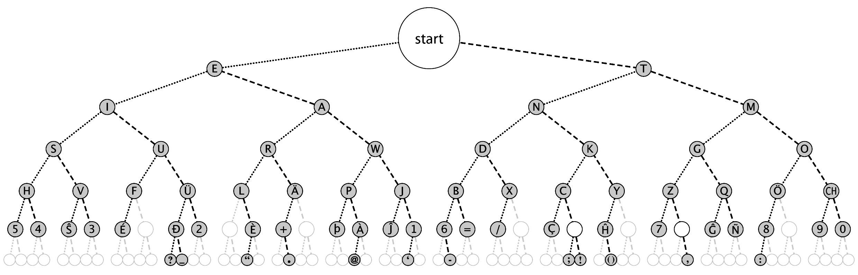
Dichotomic search

Slide 7
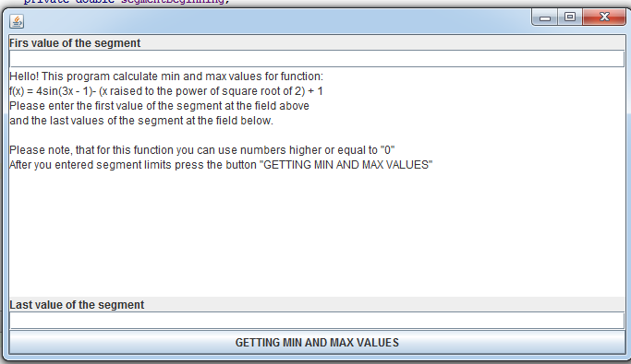
t
Notes:
The start of the program. The creation of the UserForm.

Slide 8
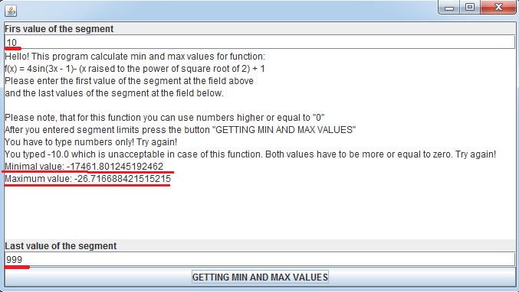
t
Notes:
The correct execution of the program, when in the both field the user typers doulbe valuse which are bigger or equal to “0”

Slide 9
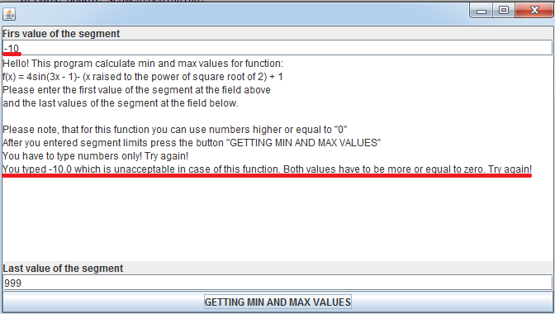
t
Notes:
When the user types a nagative value in either field NegativeNumberException is called

Slide 10
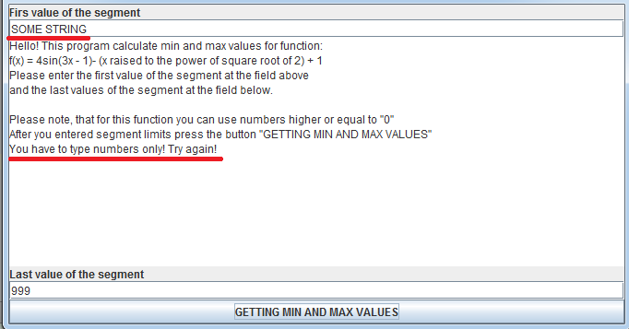
t
Notes:
When the user types a string instead of a double NumberFormatException is called

Slide 11
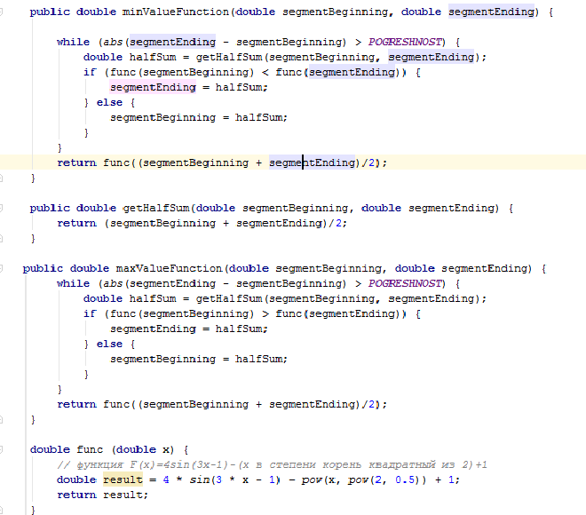
Notes:
Main “magic” of the progam - the part wich actually find the min and max values.

Slide 12
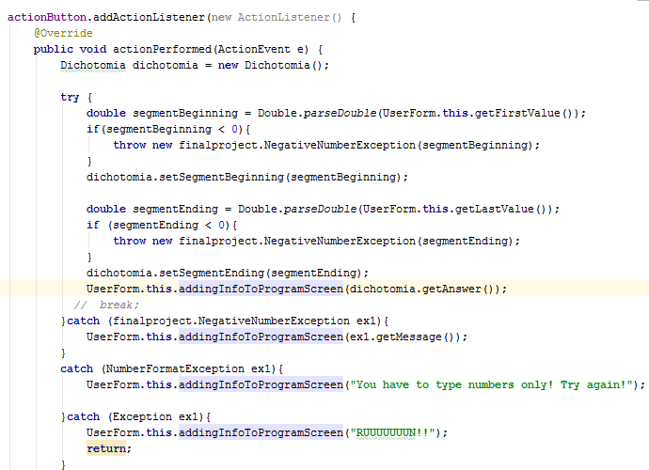

Slide 13
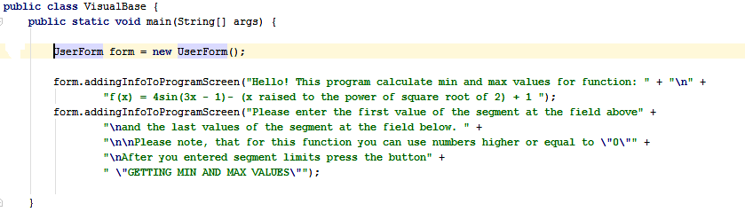
Notes:
The class with the main() method which calls the instance of UserForm class

Slide 14
Resources:
1.https://en.wikipedia.org/wiki/Dichotomy
2.http://math.semestr.ru/optim/dichotomy.php
3.https://en.wikipedia.org/wiki/Bisection_method
4.https://funjava.wordpress.com/2007/10/16/dichotomy-think-like-a-computer-so-stupid-but-so-intelligent/
5.Cay S. Horstmann "Core Java 2, Volume I--Fundamentals"
6.http://www.intuit.ru/studies/courses/1020/188/lecture/4929
7.http://www.quizful.net/post/java-exceptions
8.https://en.wikipedia.org/wiki/Dichotomic_search
Notes:
Интернет ресурсы:

Slide 15


These are the results of our first experience in the online course "Java core"
More to come!

